Slide 1


Hii, IamSiddhika
Welcome to Power BI Series
Part -36

Slide 2



Today Content
We focus only on the most used and important Dax Functions
I’m soo Excited.
Are you ready guys?
Meet DAX
COMMON FUNCTION CATEGORIES
4. FILTER FUNCTIONS (FEW MORE)
RANK UNDERSTANDING
HOW IT DIFFERS FROM
RANKX

Slide 3


RANK
Not
understood?
Let’s see
with example
The RANK function ranks each item with more control over sorting and ties. You can specify multiple columns to sort by and the order of sorting.
next
RANK ( [<ties>][, <relation> or <axis>][, <orderBy>][,
<blanks>][, <partitionBy>][, <matchBy>][, <reset>] )
Syntax

Slide 4

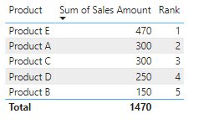
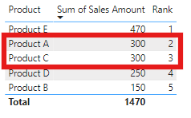

Visual Example for better understanding
You have a table named Products with columns Product and Sales Amount. Write a DAX measure using the RANK function to rank products based on their sales amount in descending order. In the case of ties, further rank the products by their names in ascending order
Example
Understood?
DENSE specifies that ties should be handled densely, meaning tied values receive the same rank, and the next rank continues sequentially. If you use SKIP then it will skip the rank and goes to next rank.
ALLSELECTED(Products[Product]) considers all selected products, preserving any external filters.
ORDERBY([Sales Amount], DESC, Products[Product], ASC) - First, rank by Sales Amount in descending order.
If there are ties, use the Product name in ascending order as the secondary sorting criterion.

Slide 5
RANKX
Not
understood?
Let’s see
with example
The RANKX function ranks each item in a table based on a value (like sales) in either ascending or descending order. It can handle ties (items with the same value) by giving them the same rank and continuing sequentially.
next
Syntax
RANKX(<table>, <expression>[, <value>[, <order>[,
<ties>]]])

Slide 6
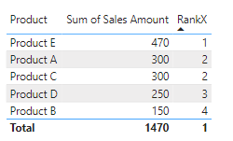
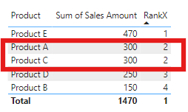
Visual Example for better understanding
Example
You have a table named Products with columns Product and Sales Amount. Write a DAX measure using the RANKX function to rank products based on their sales amount in descending order, handling ties by assigning the same rank and continuing sequentially.
Understood?
ALLSELECTED(Products[Product]) considers all selected products, preserving any external filters.
[Sales Amount] - This is the column by which we are ranking. (blank) No specific value to rank is provided because it is optional. DESC specifies that the ranking should be in descending order.
DENSE specifies that ties should be handled densely, meaning that tied values receive the same rank, and the next rank continues sequentially. If you use SKIP then it will skip the rank and goes to next rank.

Slide 7

Understanding difference of RANK and RANKX
RANK RANKX
Understood?
Product A and Product C both have a Sales Amount of
300. Since ties are handled densely but secondary sorting is applied, Product A gets rank 1 and Product C gets rank 2 (because of ascending order of product names).
Product D has a Sales Amount of 250, so it gets rank 3. Product B has a Sales Amount of 150, so it gets rank 4.
Product A and Product C both have a Sales Amount of 300. They share rank 1 due to the DENSE ranking.
Product D has a Sales Amount of 250, so it gets rank 2.
Product B has a Sales Amount of 150, so it gets rank 3.
RANK Provides more control and flexibility with multiple sorting criteria and specific ordering methods, useful for complex ranking scenarios.
RANKX Primarily used for simple ranking based on one expression, with an option to specify how to handle ties.

Slide 8


Thank you for joining me today to learn about Part -36 of Power BI!
Remember, Learning DAX is key to unlocking the full potential of Power BI for insightful reporting and visualization.
Stay tuned for more insights and tips on Power BI in our next Series.
Follow
Siddhika Shah

